Slide 1
C Strings
A C string is a variable-length array of characters that is delimited by the null character.
Topics discussed in this section:
Storing Strings
The String Delimiter
String Literals
Strings and Characters
Declaring Strings
Initializing Strings
Strings and the Assignment Operator
Reading and Writing Strings

Slide 2
Storing Strings

Slide 3
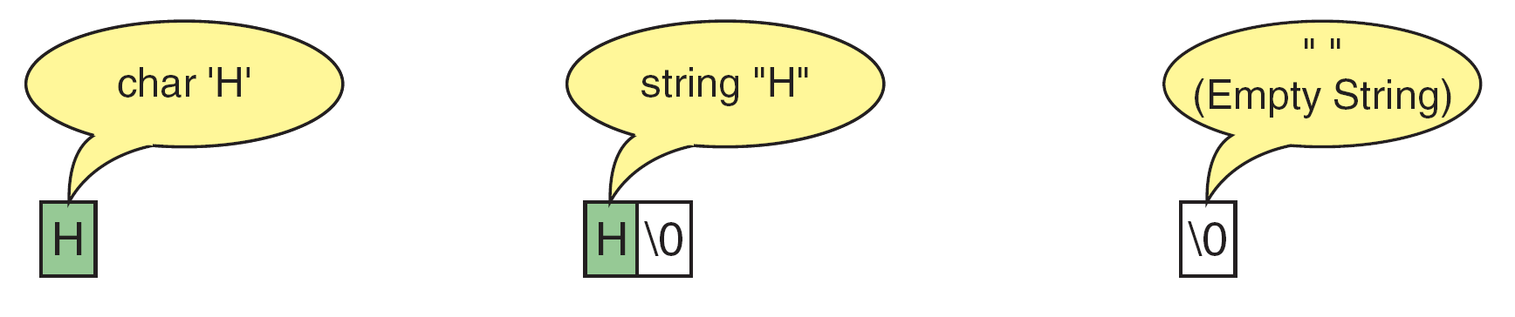
Storing Strings and Characters

Slide 4
Differences Between Strings and Character Arrays

Slide 5
Strings in Arrays

Slide 6
Note
A string literal is enclosed in double quotes.

Slide 7
Character Literals and String Literals

Slide 8
String Literal References

Slide 9
Defining Strings

Slide 10
Note
Memory for strings must be allocated before the string can be used.

Slide 11
Initializing Strings

Slide 12
String Input/Output Functions
C provides two basic ways to read and write strings. First, we can read and write strings with the formatted input/output functions, scanf/fscanf and printf/fprintf. Second, we can use a special set of string-only functions, get string (gets/fgets) and put string ( puts/fputs ).
Topics discussed in this section:
Formatted String Input/Output
String Input/Output

Slide 13
Note
The string conversion code(s) skips whitespace.

Slide 14
Reading Strings

Slide 15
Note
Always use a width in the field specification when reading strings.

Slide 16
Note
The maximum number of characters to be printed is specified by the precision in the format string of the field specification.

Slide 17
Demonstrate String Scan Set

Slide 18
Demonstrate String Scan Set

Slide 19
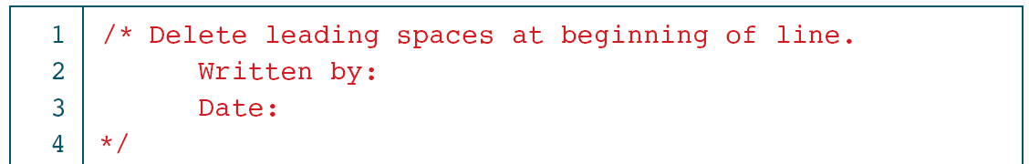
Delete Leading Whitespace

Slide 20
Delete Leading Whitespace

Slide 21
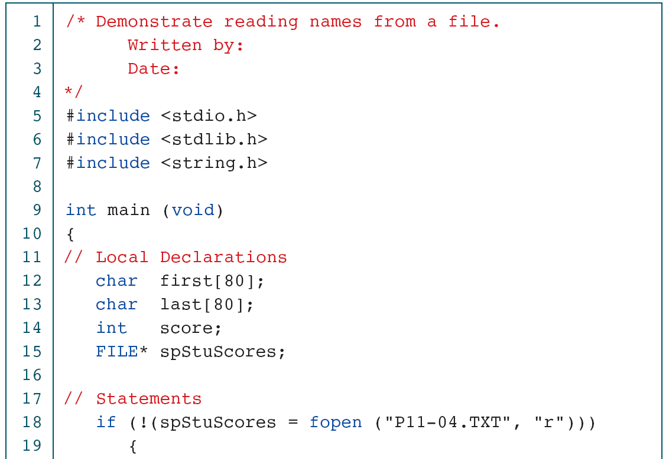
Read Student Names and Scores

Slide 22
Read Student Names and Scores

Slide 23
gets and fgets Functions

Slide 24
Demonstrate fgets Operation

Slide 25
Demonstrate fgets Operation

Slide 26
puts and fputs Operations

Slide 27
Demonstration of Put String

Slide 28
Demonstration of Put String

Slide 29
Typewriter Program

Slide 30
Typewriter Program

Slide 31
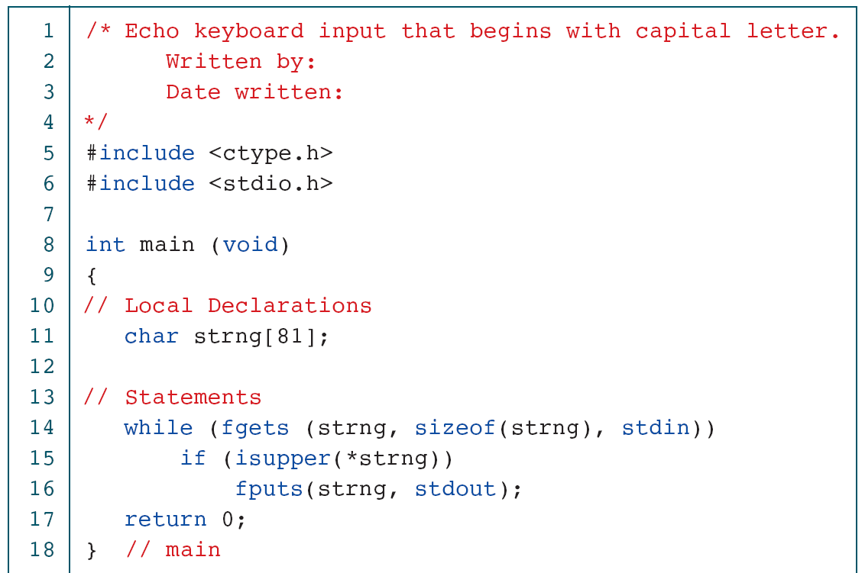
Print Selected Sentences

Slide 32
Print Selected Sentences

Slide 33
Print File Double spaced

Slide 34
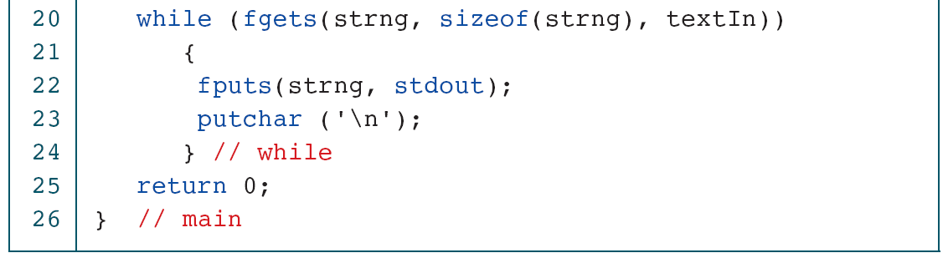
Print File Double spaced

Slide 35
Arrays of Strings

Slide 36
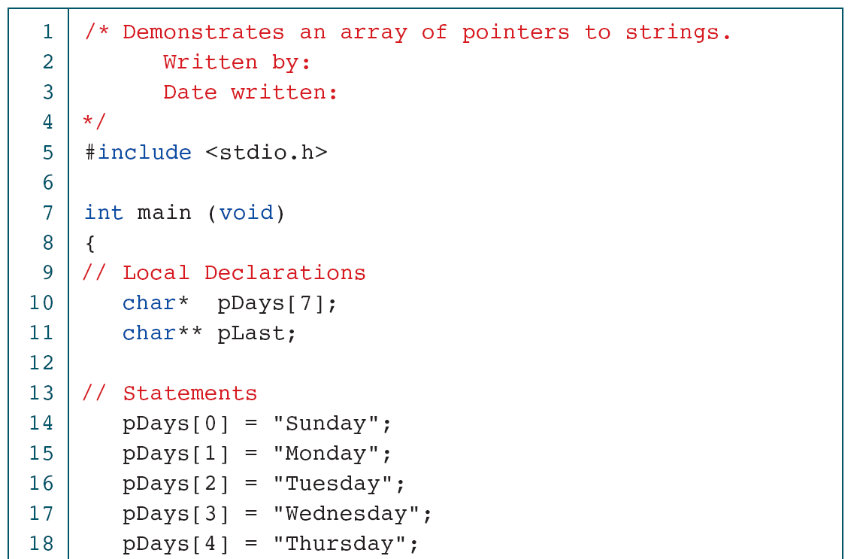
Print Days of the Week

Slide 37
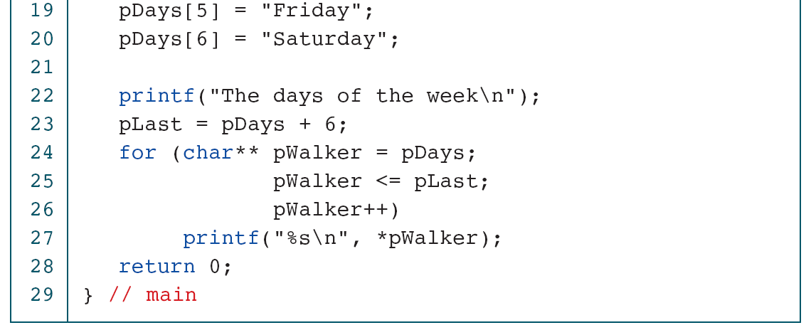
Print Days of the Week

Slide 38
Pointers to Strings

